Slide 1

TRANSCRIPTION
OF DNA

Slide 2
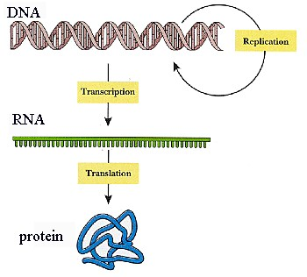

Slide 3
Transcription is defined as synthesis of RNA molecule based up on the single strand of double stranded DNA molecule.
The strand on which the RNA molecule synthesis depends is called as template strand
Opposite to the template strand is called as anti template strand or coding strand
Coding strand is similar to RNA molecule but it contains “T” instead of “U”

Slide 4
SIMILARITIES WITH REPLICATION
Both are synthesized in similar manner of intiation, elongation and termination
Both are proceed in 5’ -3’ direction during synthesis
Both are obeying watson and crick basepair rules
These two processes are differs in several ways

Slide 5
DIFFERENCES WITH REPLICATION
Ribonucleotides are used in RNA synthesis rather than deoxyribonucleotides in DNA synthesis
“U” replaces the “T” in RNA
Primer is not required for RNA synthesis
Only a small portion of genome is copied to RNA
There is no proof reading action during RNA synthesis
One strand of DNA molecule is sufficient for RNA synthesis

Slide 6
There are mainly 5 types of RNA’s synthsized by DNA dependent RNA polymerase enzyme
These are :
Heterogenous nuclear RNA
mRNA
rRNA
tRNA
SnRNA (Snurpe RNA)

Slide 7
DNA DEPENDENT RNA POLYMERASE
(RNAP)
It is a metallo enzyme contains two Zn molecules in its structure
This is polymerizing ribonucleotides in the synthesis of RNA as like DNA pol. In replication
Its different in prokaryotes and in eukaryotes
Prokaryotic enzyme having 6 subunits as α₂ββ’σω
Eukaryotic enzyme having 14 subunits
RNA pol. Has the unwindase (helicase) activity seperate the two DNA strands.
Topoisomerase are follows this for negative supercoiling

Slide 8
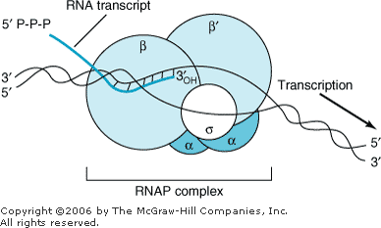

Slide 9
Eukaryotic RNAP enzyme is 3 types as
RNA pol-l, RNA pol-ll, RNA pol-lll
3 enzymes synthesizes the rRNA,mRNA,tRNA respectively
Prokaryotic enzymatic subunit σ-factor is responsible for recognition of promoter sequence for RNA synthesis
β-subunit having the polymerizing capacity.
α-subunit have the promoter binding capacity
RNAP requires DNA for it’s activity and it will be more active when it binds to DNA

Slide 10
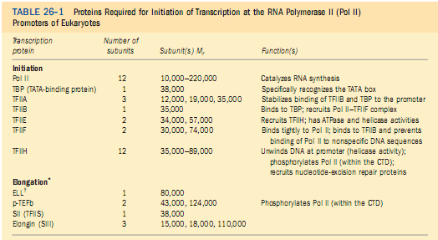

Slide 11
PROMOTER REGION
The region of DNA molecule which acts as a binding site for RNA polymerase with high affinity
Prokaryotic genome contains “TATATT”sequence at -10bp’s upstream from transcription intiation site and its called as PRIBNOW BOX or TATA BOX
“TGTTGACA” sequence at -35bp’s away in upstream called as GACA BOX

Slide 12
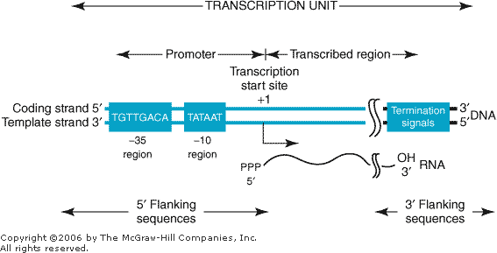

Slide 13
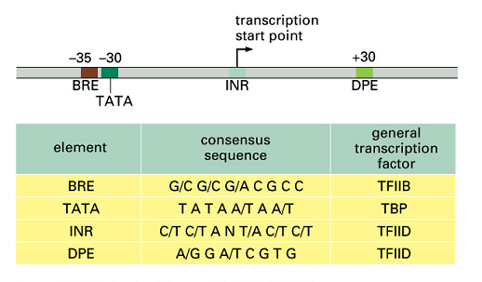

Slide 14
Eukaryotic genome contains TATAAAG sequence at 25-30bp’s resembles TATA BOX in prokaryotes
This TATA box is bounded with TBP’S and TAF’S in eukaryotes
Further upstream between -70to-80bp’s another sequence is GGCCAATCT, known as CAATBOX
Binding of TATA with TFllD is thought to represent the first step in the formation of transcription complex on the promoter
Inr’s and DPE’s

Slide 15
PROMOTER BINDING IN PROKARYOTES
RNAP enzyme binds with TGTTGACA sequence and forms closed complex
Before the starting of initiation process σ-subunit of prokaryotic enzyme recognises the TATABOX and binds along with core enzyme
This AT rich region has a low melting temperature and at this area strand separation is easy before transcription
Open complex

Slide 16
PROMOTER BINDING IN EUKARYOTES
Unlike in prokaryotes the binding of RNAP with promoter is more complex in eukaryotes
The promoter is divided in to proximal TATA box region and distal CAAT box region
Proximal region defines where transcription is to commence
Distal region specifies the frequency of intiation

Slide 17
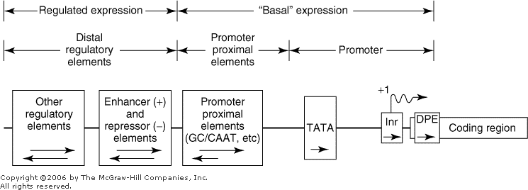

Slide 18
PRE INTIATION COMPLEX
In bacteria σ-factor –pol.complex selectively bound to the DNA in the promoter forming PIC
Eukaryotic RNAP’s are not able to discriminate between promoter sequence and other regions of DNA;thus other proteins known as general transcription factors (GTF’S) facilitate promoter specific binding of these enzymes and formation of PIC
Ex: TFIIA,TFIIB,TFIID….TFIIH

Slide 19
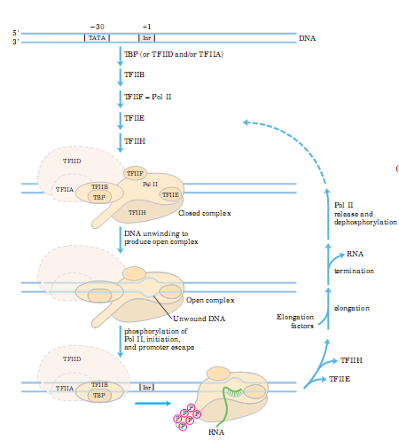

Slide 20
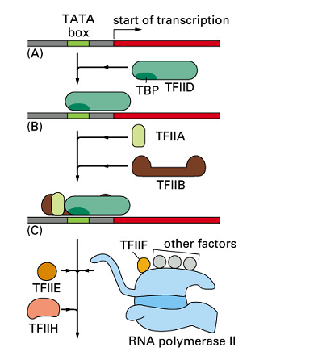

Slide 21
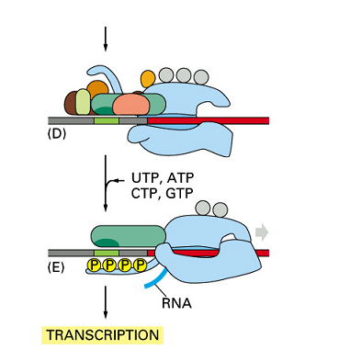

Slide 22
TBP binds to the TATABOX in the minor groove of DNA and causes approximately 100degree bend or kink of DNA helix
This bending is thought to facilitate interaction of TBP associated factors with other components of transcription intiation complex
Carboxy terminal repeat domain(CTD)
ACTIVATORS AND COACTIVATORS
Notes:
Ught

Slide 23
The protein DNA interaction at the TATA BOX involving RNAP and other components of PIC ensures the fidelity of initiation
ENHANCERS AND REPRESSORS:
These are elements which can present in either upstream or downstream from intiation site
Acts independent on orientation
And If away from100-1000bp’s shows their action

Slide 24
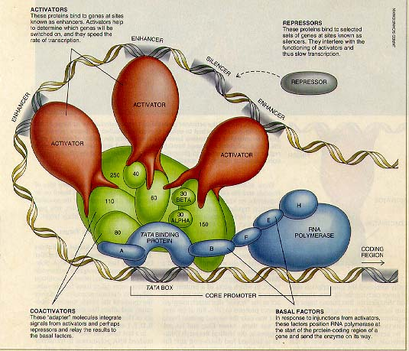

Slide 25
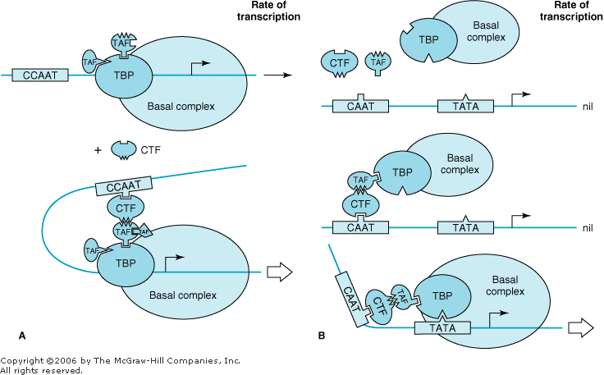

Slide 26
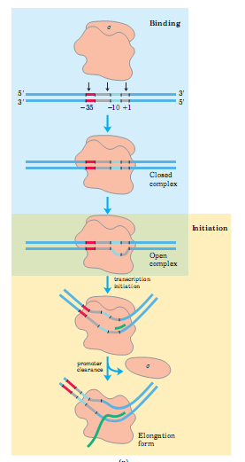

Slide 27
INTIATION AND ELONGATION
After formation of open complex σ-factor will dissociate from core enzyme
RNAP moves in 3’-5’ direction and synthesizes the RNA molecule in 5’-3’ direction
In both pro and eukaryotes a purine nucleotide is usually the first to be into the RNA molecule
Ribonucleotides are joining to the 3’ end of RNA molecule and releasing one Ppi molecule for every addition.
Ppi molecule is degraded by pyrophsphatase to two-P molecules and this gives the irrversibility to entire process

Slide 28
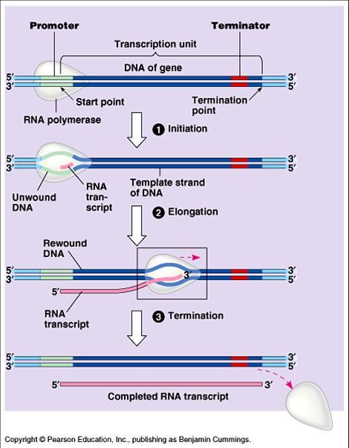

Slide 29
TERMINATION OF TRANSCRIPTION
There are 2 types of terminations:
Rho(ρ)dependent termination
Rho independent termination

Slide 30
RHO(ρ) PROTEIN
Rho protein is having ATP dependent RNA-DNA helicase activity
This protein will assembled with transcript rich in GC region and follows the RNAP
When the RNAP reaches the termination site or perhaps pause for too long, ρ-protein can catch up and disrupt the hydogen bonding between DNA-RNA and terminate the process

Slide 31
GC rich regions on the transcript form a stem loop structure with a series of uridine residues at about 20bp’s away from termination
This will cause mRNA to hybridise with itself rather than with the DNA.
This causes the RNAP to pause and disrupts the RNA-DNA hybrid helix, ultimately causing its release
In eukaryotes termination is well defined
more than one RNAP molecule can transcribe the same template of gene simultaneously

Slide 32
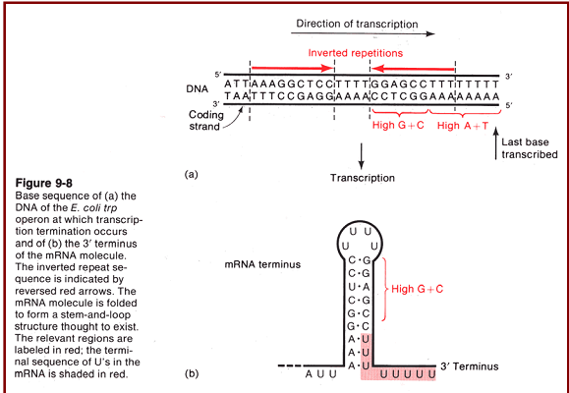

Slide 33
INHIBITORS OF TRANSCRIPTION
ACTINOMYCIN-D
ACRIDINE
RIFAMPICIN
STREPTOVARICIN
STREPTOGLYDIGIN
HEPARIN
All the above antibiotics binds with β’-subunit of bacterial RNAP and inhibits its action of polymerising
α- amnatin
3-deoxyadenosine

Slide 34
mRNA EDITING IS POSSIBLE?
By the traditional central dogma principle its impossible to edit the coding information at mRNA level
Apo B100 gene is example for possible mRNA editing
“Cytidine deaminase”

