Slide 1
DIGESTION AND ABSORPTION OF LIPIDS

Slide 2
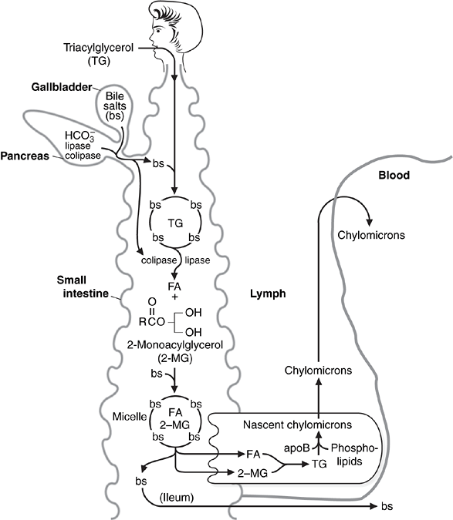

Slide 3
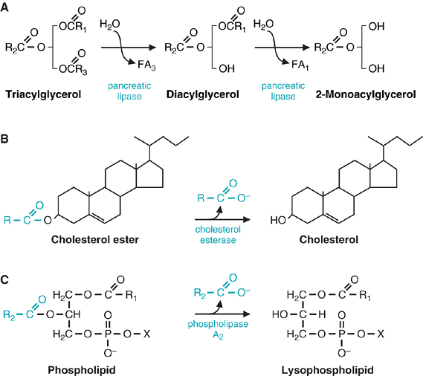

Slide 4
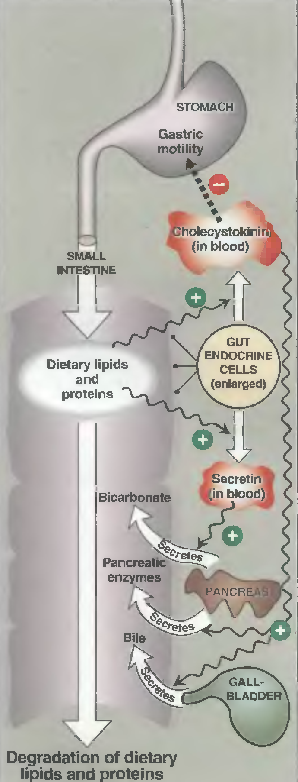

Slide 5
Dietary fat leaves the stomach and enters the small intestine, where it is emulsified (suspended in small particles in the aqueous environment) by bile salts. The bile salts are amphipathic compounds (containing both hydrophobic and hydrophilic components), synthesized from cholesterol in the liver and secreted via the gallbladder into the intestinal lumen. The contraction of the gallbladder and secretion of pancreatic enzymes are stimulated by the gut hormone cholecystokinin, which is secreted by the intestinal cells when stomach contents enter the intestine.
Bile salts act as detergents, binding to the globules of dietary fat as they are broken up by the peristaltic action of the intestinal muscle. This emulsified fat, which has an increased surface area as compared with unemulsified fat, can be more efficiently attacked by digestive enzymes from the pancreas.

Slide 6
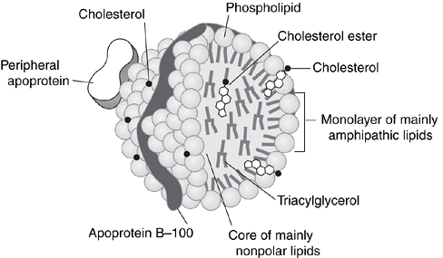

Slide 7
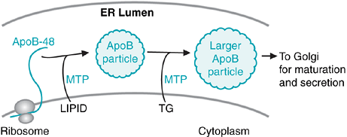

Slide 8
The assembly of chylomicrons within the endoplasmic reticulum of the intestinal epithelial cell (enterocyte) requires the activity of microsomal triglyceride transfer protein (MTP). MTP accelerates the transport of triglycerides, cholesterol esters, and phospholipids across membranes of subcellular organelles. It is required for both chylomicron assembly in the intestine and VLDL assembly in the liver. Both chylomicrons and VLDL require apoB for their assembly (apoB-48 for chylomicrons, apoB-100 for VLDL), and MTP binds to the apoBs.

Slide 9
The appropriate apoB is made on the rough endoplasmic reticulum and is inserted into the endoplasmic reticulum lumen during its synthesis.
As the protein is being translated, lipid (a small amount of triglyceride) begins to associate with the protein, and the lipid association is catalyzed by MTP. This leads to the generation of small apoB-containing particles.
The second stage of particle assembly is the fusion of the initial apoB particle with triacylglycerol droplets within the endoplasmic reticulum. MTP also may be required for the transfer of triacylglycerol from the cytoplasm to the lumen of the endoplasmic reticulum to form this lipid droplet.

Slide 10
The lack of triglyceride transfer activity leads to the disease abetalipoproteinemia. This disease affects both chylomicron assembly in the intestine and VLDL assembly in the liver. The small apoB-containing particles are not formed in patients with abetalipoproteinemia.
Thus, it appears as though MTP activity is necessary to transfer triacylglycerol formed within the endoplasmic reticulum to apoB. The symptoms of abetalipoproteinemia include lipid malabsorption (and its accompanying symptoms, such as steatorrhea and vomiting), which can result in caloric deficiencies and weight loss. Because lipid-soluble vitamin distribution occurs through chylomicron circulation, signs and symptoms of deficiencies in the lipid-soluble vitamins may be seen in these patients.

Slide 11
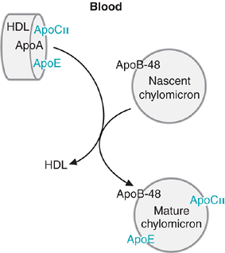

Slide 12
HDL transfers proteins to the nascent chylomicrons, particularly the apolipoproteins apoE and apoC-II.
ApoE is recognized by membrane receptors, particularly those on the surface of liver cells, allowing apoE-bearing lipoproteins to enter these cells by endocytosis for subsequent digestion by lysosomes.
ApoC-II acts as an activator of lipoprotein lipase (LPL), the enzyme on capillary endothelial cells, primarily within muscle and adipose tissue, that digests the triacylglycerols of the chylomicrons and VLDL in the blood.

Slide 13
One manner in which individuals can lose weight is to inhibit the activity of pancreatic lipase. This would result in reduced fat digestion and absorption and a reduced caloric yield from the diet.
The drug Orlistat is a chemically synthesized derivative of lipstatin, a natural lipase inhibitor found in certain bacteria. The drug works in the intestinal lumen and forms a covalent bond with the active-site serine residue of both gastric and pancreatic lipase, thereby inhibiting their activities. Undigested triglycerides are not absorbed by the intestine and are eliminated in the feces.
Under normal use of the drug, approximately 30% of dietary fat absorption is inhibited. Because excessive undigested fat in the intestines can lead to gastrointestinal distress related to excessive intestinal gas formation, individuals taking this drug need to follow a reduced daily intake of fat in their diet, which should be evenly distributed among the meals of the day.

Slide 14
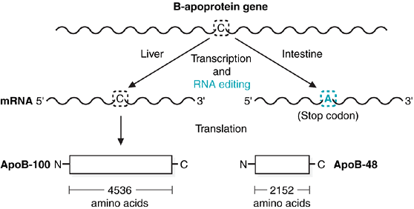

Slide 15
ApoB gene. The gene, located on chromosome 2, is transcribed and translated in liver to produce apoB-100, which is 4,536 amino acids in length (one of the longest single-polypeptide chains).
In intestinal cells, RNA editing converts a cytosine (C) to an adenine (A) in the mRNA, producing a stop codon, hence a truncated protein (apoB-48) of 2,152 amino acids. apoB-48 is 48% of the size of apoB-100.

Slide 16
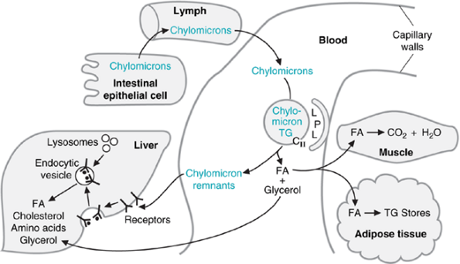

Slide 17
LIPOPROTEIN LIPASE
The triacylglycerols of the chylomicrons are digested by LPL attached to the proteoglycans on the outside of the basement membranes of endothelial cells that line the capillary walls.
LPL is produced by adipose cells, muscle cells (particularly cardiac muscle), and cells of the lactating mammary gland.
The isozyme synthesized in adipose cells has a higher Michaelis constant (K_{m}) than the isozyme synthesized in muscle cells. Therefore, adipose LPL is more active after a meal, when chylomicron levels are elevated in the blood.
Insulin stimulates the synthesis and secretion of adipose LPL. Therefore, when triglyceride levels increase in circulation after a meal, LPL has been up-regulated (through insulin release) to facilitate the hydrolysis of fatty acids from the triglyceride.

Slide 18
The fatty acids released from triacylglycerols by LPL are not very soluble in water. They become soluble in blood by forming complexes with the protein albumin. The major fate of the fatty acids is storage as triacylglycerol in adipose tissue. However, these fatty acids also may be oxidized for energy in muscle and other tissues.
Lipoprotein lipase is located on the walls of blood capillaries, anchored to the endothelium by negatively charged proteoglycan chains of heparan sulfate. It has been found in heart, adipose tissue, spleen, lung, renal medulla, aorta, diaphragm, and lactating mammary gland, although it is not active in adult liver. It is not normally found in blood; however, following injection of heparin, lipoprotein lipase is released from its heparan sulfate binding into the circulation
The LPL in the capillaries of muscle cells has a lower K_{m} than adipose LPL. Thus, muscle cells can obtain fatty acids from blood lipoproteins preferentially over adipose tissue whenever they are needed for energy, even if the concentration of the lipoproteins is low.
Heparin is a complex polysaccharide (a glycosaminoglycan) that is a component of proteoglycans. Heparin is frequently used as an anticoagulant, because it binds to antithrombin (AT), and the activated AT then binds to and inhibits factor Xa and thrombin, both of which are necessary for hemostasis. As LPL is bound to the capillary endothelium through binding to proteoglycans, heparin also can bind to LPL and dislodge it from the capillary wall.

Slide 19
Fate of glycerol
The glycerol released from chylomicron triacylglycerols by LPL may be used for triacylglycerol synthesis in the liver in the fed state.
The portion of a chylomicron that remains in the blood after LPL action is known as a chylomicron remnant. This remnant binds to receptors on hepatocytes (the major cells of the liver) which recognize apoE and is taken up by the process of endocytosis. Lysosomes fuse with the endocytic vesicles, and the chylomicron remnants are degraded by lysosomal enzymes. The products of lysosomal digestion (e.g., fatty acids, amino acids, glycerol, cholesterol, phosphate) can be reused by the cell.

Slide 20
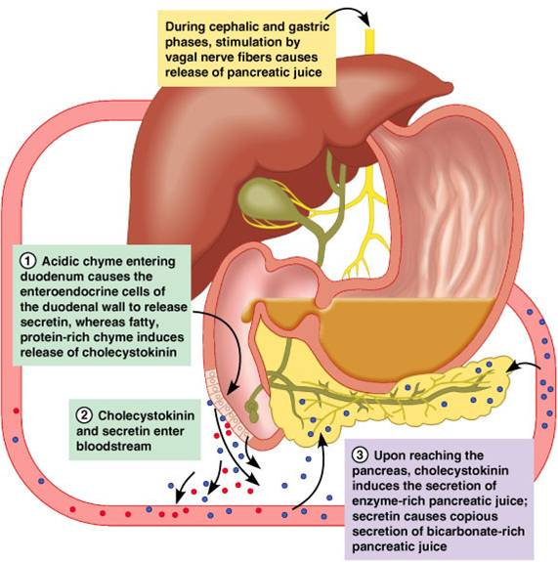

Slide 21
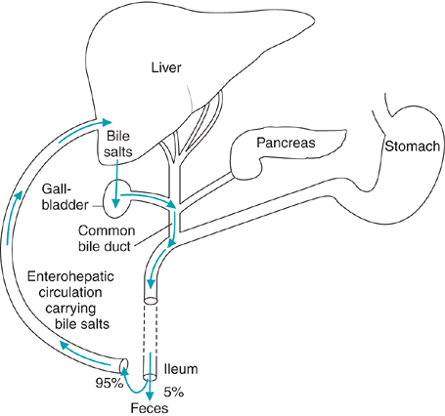

Slide 22
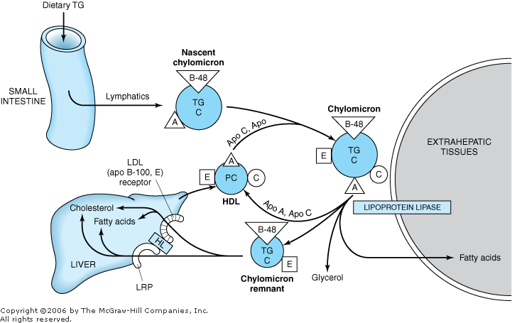

Slide 23
At a glance…..
Triacylglycerols are the major fat source in the human diet.
Lipases (lingual lipase in the saliva and gastric lipase in the stomach) perform limited digestion of triacylglycerol prior to entry into the intestine.
Cholecystokinin is released by the intestine as food enters, which signals the gallbladder to release bile acids and the exocrine pancreas to release digestive enzymes.
Within the intestine, bile salts emulsify fats, which increases their accessibility to pancreatic lipase and colipase.
Triacylglycerols are degraded to form free fatty acids and 2-monoacylgylcerol by pancreatic lipase and colipase.
Dietary phospholipids are hydrolyzed by pancreatic phospholipase A2 in the intestine.
Dietary cholesterol esters (cholesterol esterified to a fatty acid) are hydrolyzed by pancreatic cholesterol esterase in the intestine.

Slide 24
Micelles, consisting of bile acids and the products of fat digestion, form within the intestinal lumen and interact with the enterocyte membrane. Lipid-soluble components diffuse from the micelle into the cell.
Bile salts are resorbed farther down the intestinal tract and returned to the liver by the enterohepatic circulation.
The intestinal epithelial cells resynthesize triacylglycerol and package them into chylomicrons for release into the circulation.
Once in circulation the nascent chylomicrons interact with high-density lipoprotein particles and acquire two additional protein components; apolipoproteins C-II and E.
ApoCII activates lipoprotein lipase on capillary endothelium of muscle and adipose tissue, which digests the triglycerides in the chylomicron. The fatty acids released from the chylomicron enter the muscle for energy production or the fat cell for storage. The glycerol released is metabolized only in the liver.
As the chylomicron loses triglyceride, its density increases, and it becomes a chylomicron remnant. Chylomicron remnants are removed from circulation by the liver through specific binding of the remnant to apolipoprotein E receptors on the liver membrane.
Once in the liver the remnant is degraded, and the lipids are recycled.

Slide 25
The mammary gland produces milk, which is the major source of nutrients for the breast-fed human infant. The fatty acid composition of human milk varies, depending on the diet of the mother. However, long-chain fatty acids predominate, particularly palmitic, oleic, and linoleic acids. Although the amount of fat in human milk and cow's milk is similar, cow's milk contains more short- and medium-chain fatty acids and does not contain the long-chain polyunsaturated fatty acids found in human milk that are important in brain development.
Although the concentrations of pancreatic lipase and bile salts are low in the intestinal lumen of the newborn infant, the fat of human milk is readily absorbed. This is true because lingual and gastric lipases produced by the infant partially compensate for the lower levels of pancreatic lipase. The human mammary gland also produces lipases that enter the milk. One of these lipases, which requires lower levels of bile salts than pancreatic lipase, is not inactivated by stomach acid and functions in the intestine for a number of hours.

Slide 26
ROLE OF LIVER IN FAT METABOLISM
It facilitates the digestion and absorption of lipids by the production of bile, which contains cholesterol and bile salts synthesized within the liver de novo or from uptake of lipoprotein cholesterol.
It actively synthesizes and oxidizes fatty acids and also synthesizes triacylglycerols and phospholipids.

